Slide 1

StockBot
Andrea Gonzalez, Enzo Migliano, Raul Ramon

Slide 2

Instructions
For this project we will assume that we are “algotraders” in a IEX stock market exchange game.
We created algorithmic trading models that buy and sell stocks in the market automatically from a script running in our own EC2 instance.
According to the rules, we need to have 250 successful trades per day, we can only trade the same
Our goal is to maximize our profit as a team to beat out all of the other hedge funds while trying to avoid getting penalties from the game’s rules.

Slide 3

Strategy #1
STRATEGIES
Normalization min-max: By doing min-max normalization we will normalize the data and for every feature the minimum value gets transformed into a 0, the maximum value gets transformed into a 1, and every other value gets transformed into a decimal between 0 and 1.
Our goal is to use normalization is to transform features to be on a similar scale. This will improve the performance and training stability of the model to help us decide which stock is will result will be better to buy or sell according to its value.

Slide 4
Strategy #2
Candlestick Method: In this bot. We utilized the candles to seek for trends in the date. We would record the previous closing point and the current closing point.
If the current closing point was higher than the last closing point
If not we would wait
We would only sell if the price we bought was lower than the current price

Slide 5
Strategy #3
Moving Average: It will be our backward-looking indicator and it will rely on past price data to try to predict future averages of the stocks.
In statistics, a moving average is a calculation used to analyze data points by creating a series of averages of different subsets of the full data set.
The reason for calculating the moving average of a stock is to help smooth out the price data by creating a constantly updated average price
By calculating the moving average, the impacts of random, short-term fluctuations on the price of a stock over a specified time-frame are mitigated.
A simple moving average (SMA) is a calculation that takes the arithmetic mean of a given set of prices over the specific number of days in the past.
Exponential moving averages (EMA) is a weighted average that gives greater importance to the price of a stock on more recent days.

Slide 6
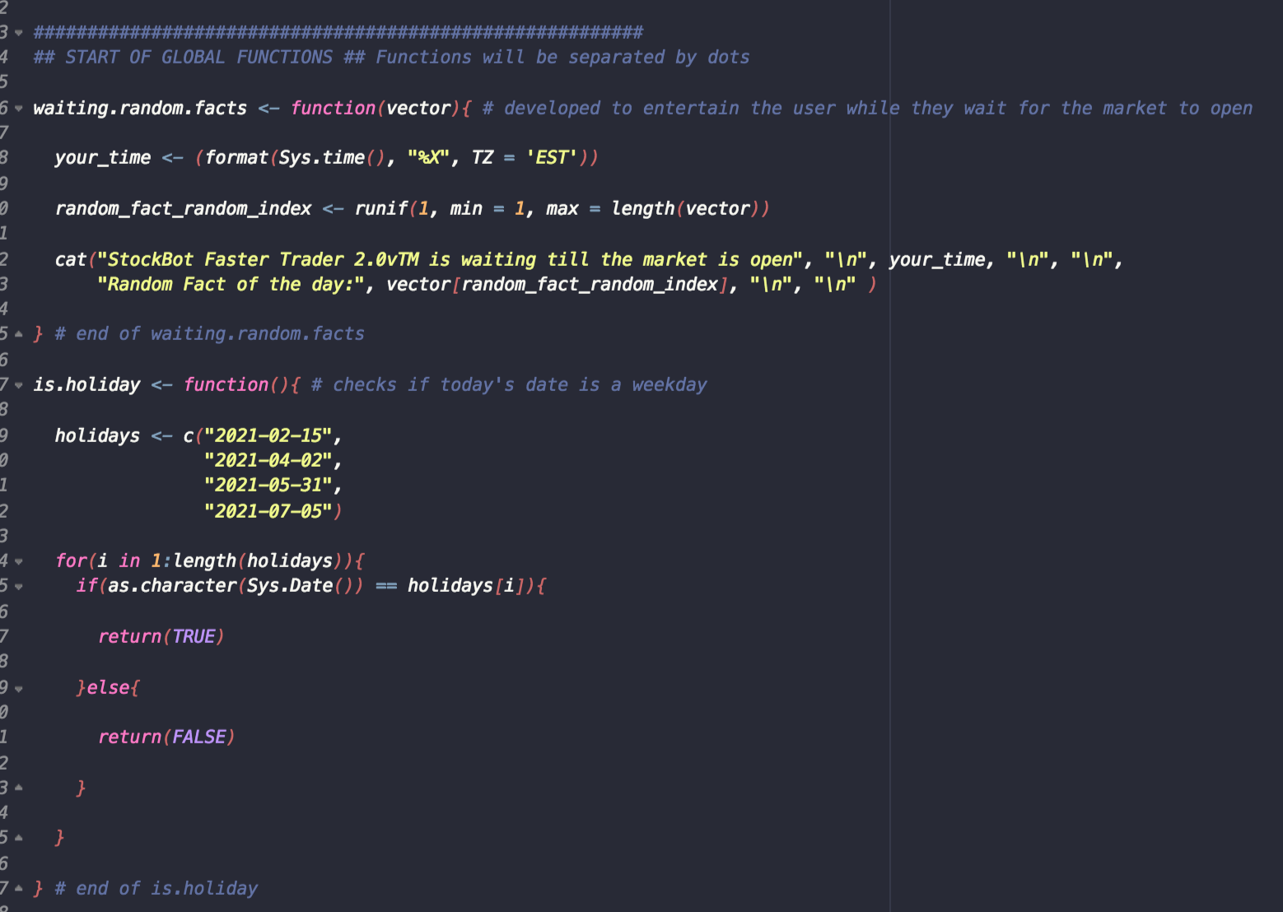
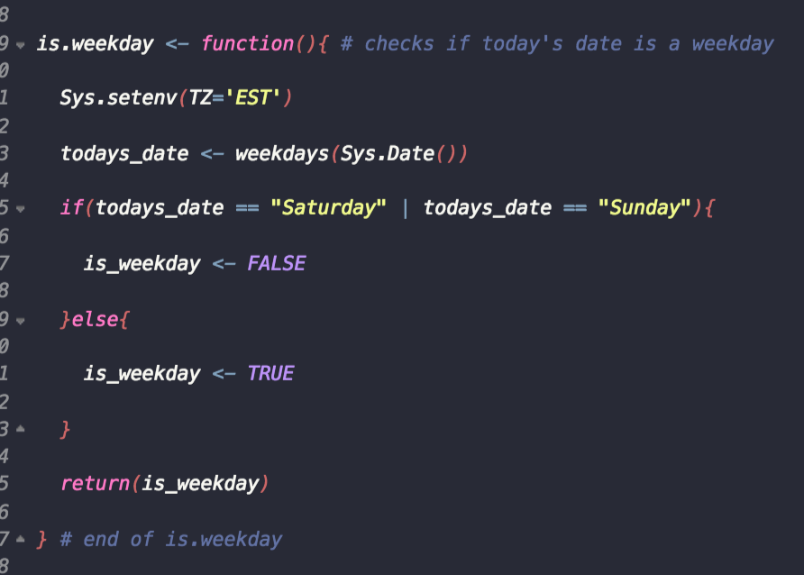
First steps...
Assigning the correct dates and times so that our code will run the hours and the days that the market is open, to do this correctly we had to set the times to eastern time zone so our code will be in the same time zone as the tiingo stock market

Slide 7
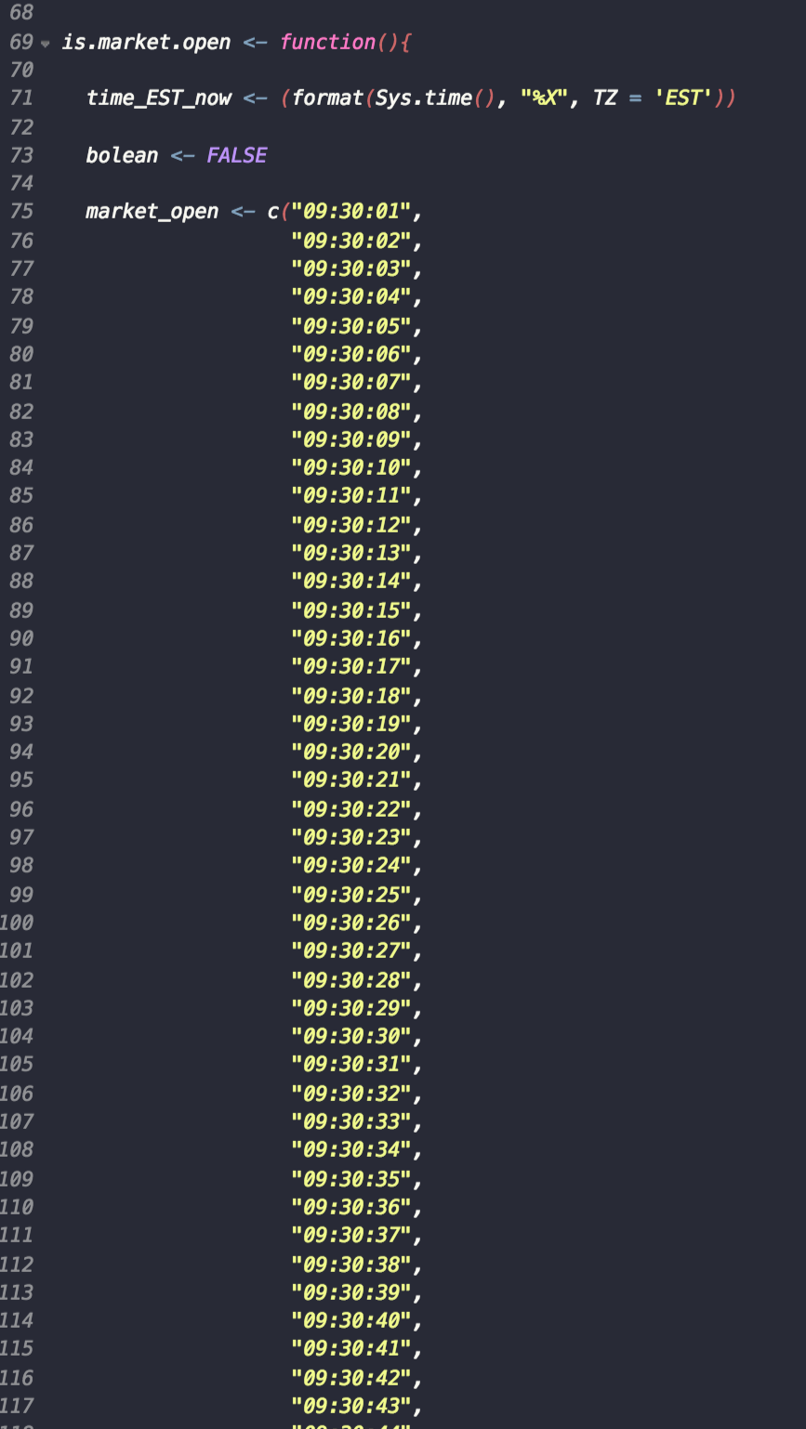
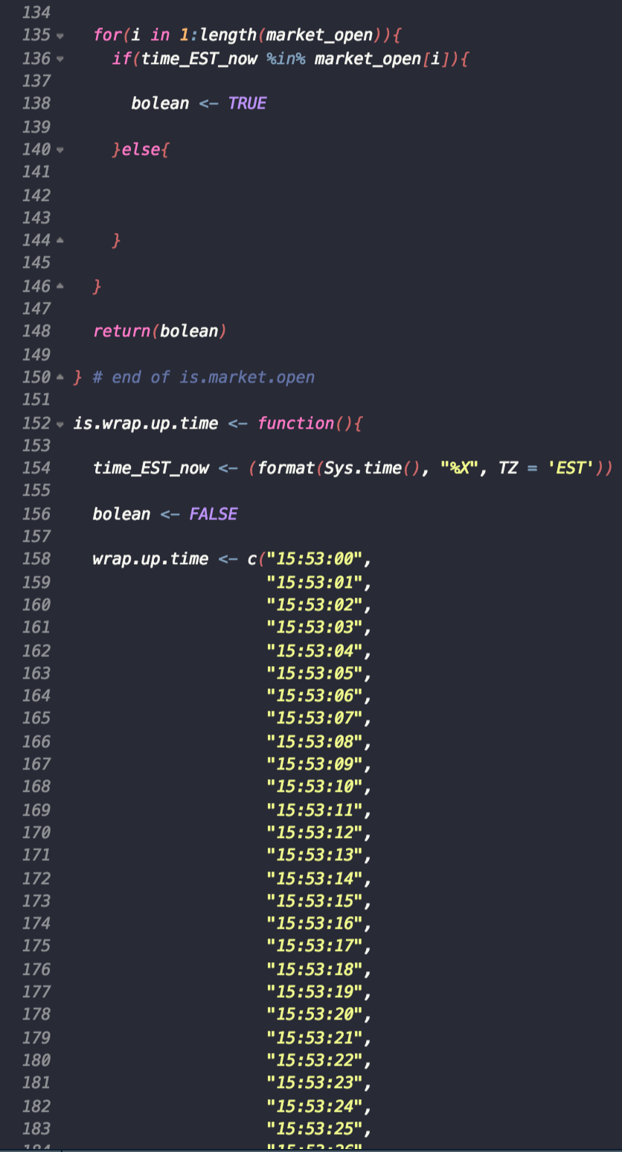
Setting up the market times
This function will tell our bot when the market will open and close
The time format is Hour:Minute:Seconds
We wanted to start wrapping up 7 minutes before the market closed to avoid errors and penalties

Slide 8
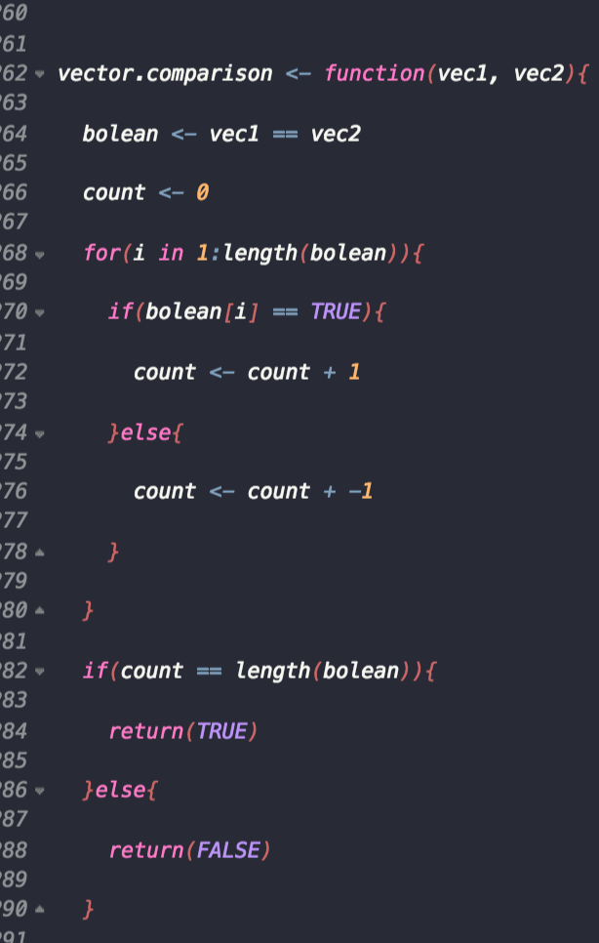
Checking for errors
This function will be utilized to check for errors in the in buying and selling stocks and for the time to open and close the market

Slide 9
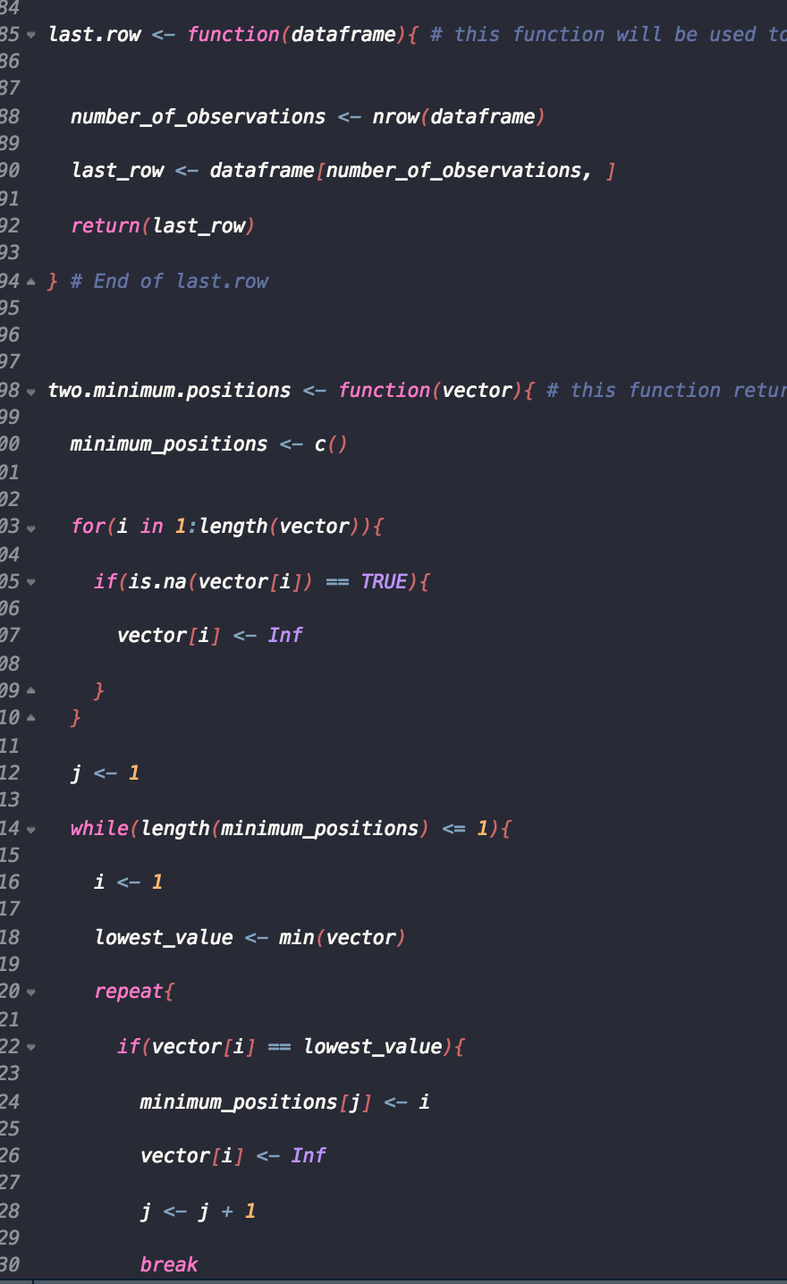
Getting historical data and values
This function will help us get the historical data from Tiingo
It return the lowest and highest values given in the vector

Slide 10
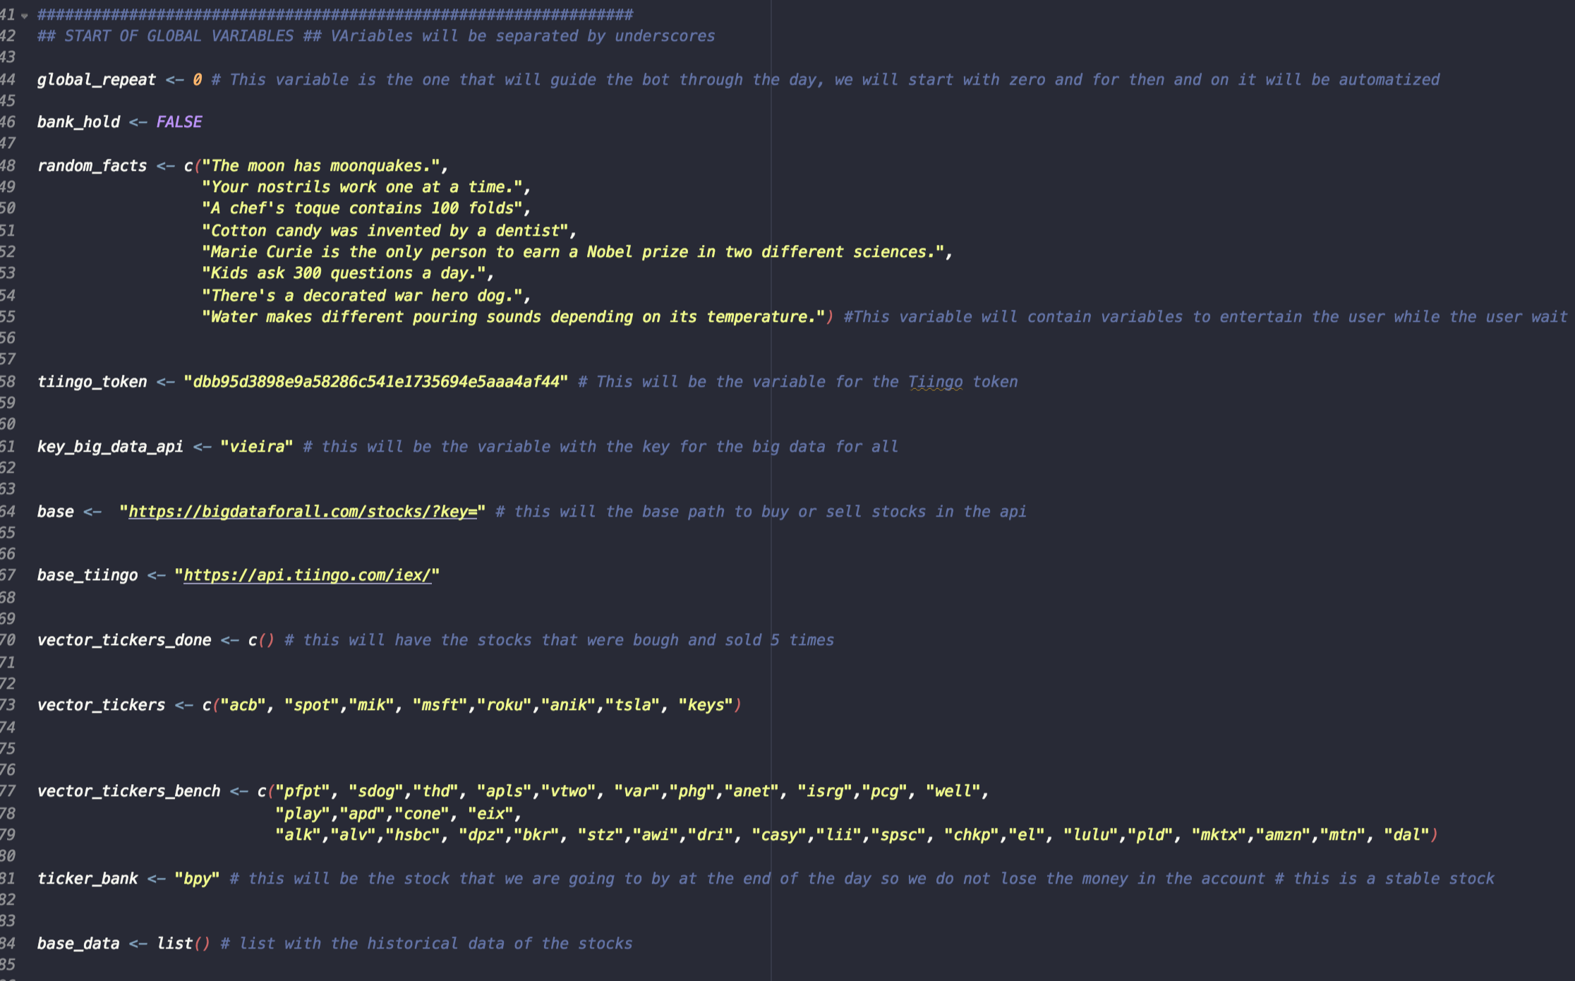
Setting our global variables
After setting our starting money value which was $100,000 and the stocks we were going to work with, we built a loop that will start by buying one specific stock, and then it will start the process of buying and selling our main list of stocks selected according to its previous stocks value, meaning that it will buy the stocks with lower value and keep or sell the ones with higher values.

Slide 11
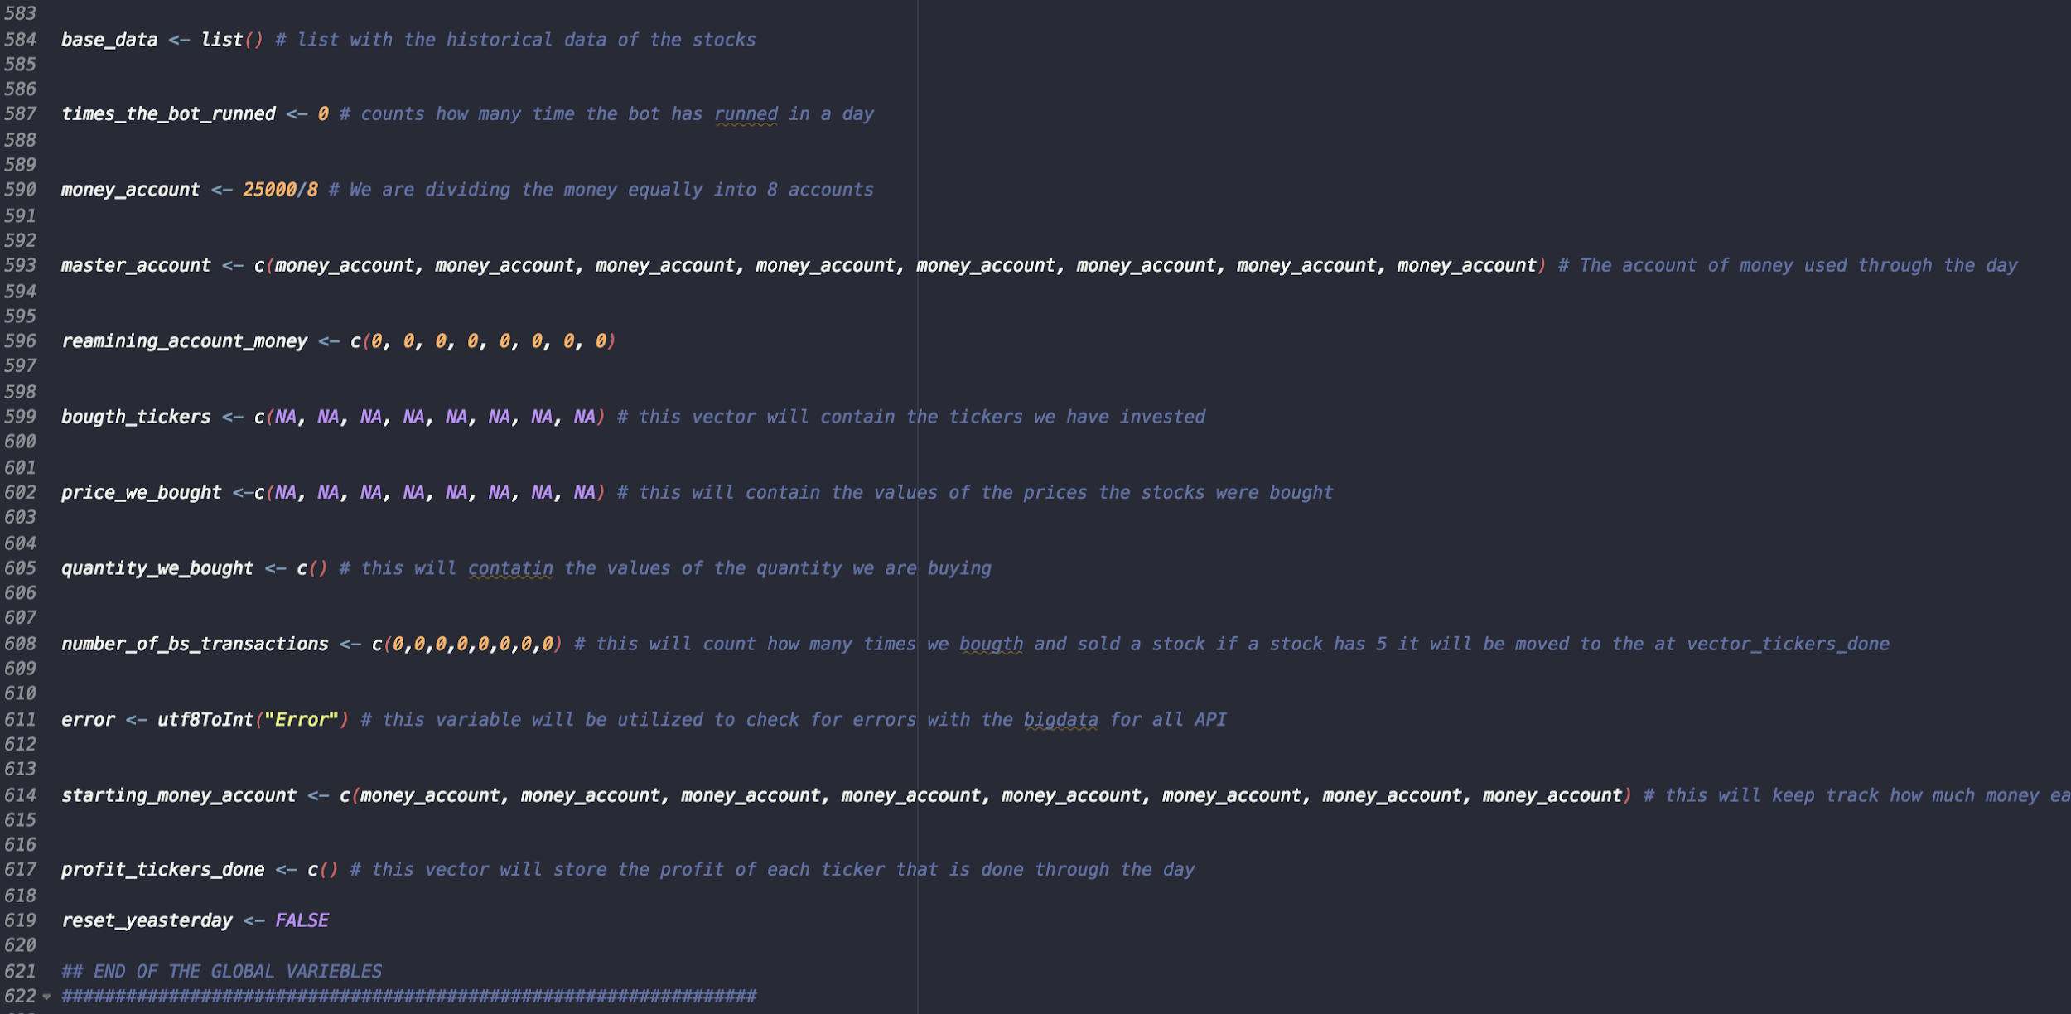
We created a function as an “in case of emergency” called ticker_bank that will buy a stock that we assigned to it at the end of the day, so we do not get penalized and lose the money that we have in the account. The stock chosen was bpy because it is a stable and safe to use for this purpose.

Slide 12
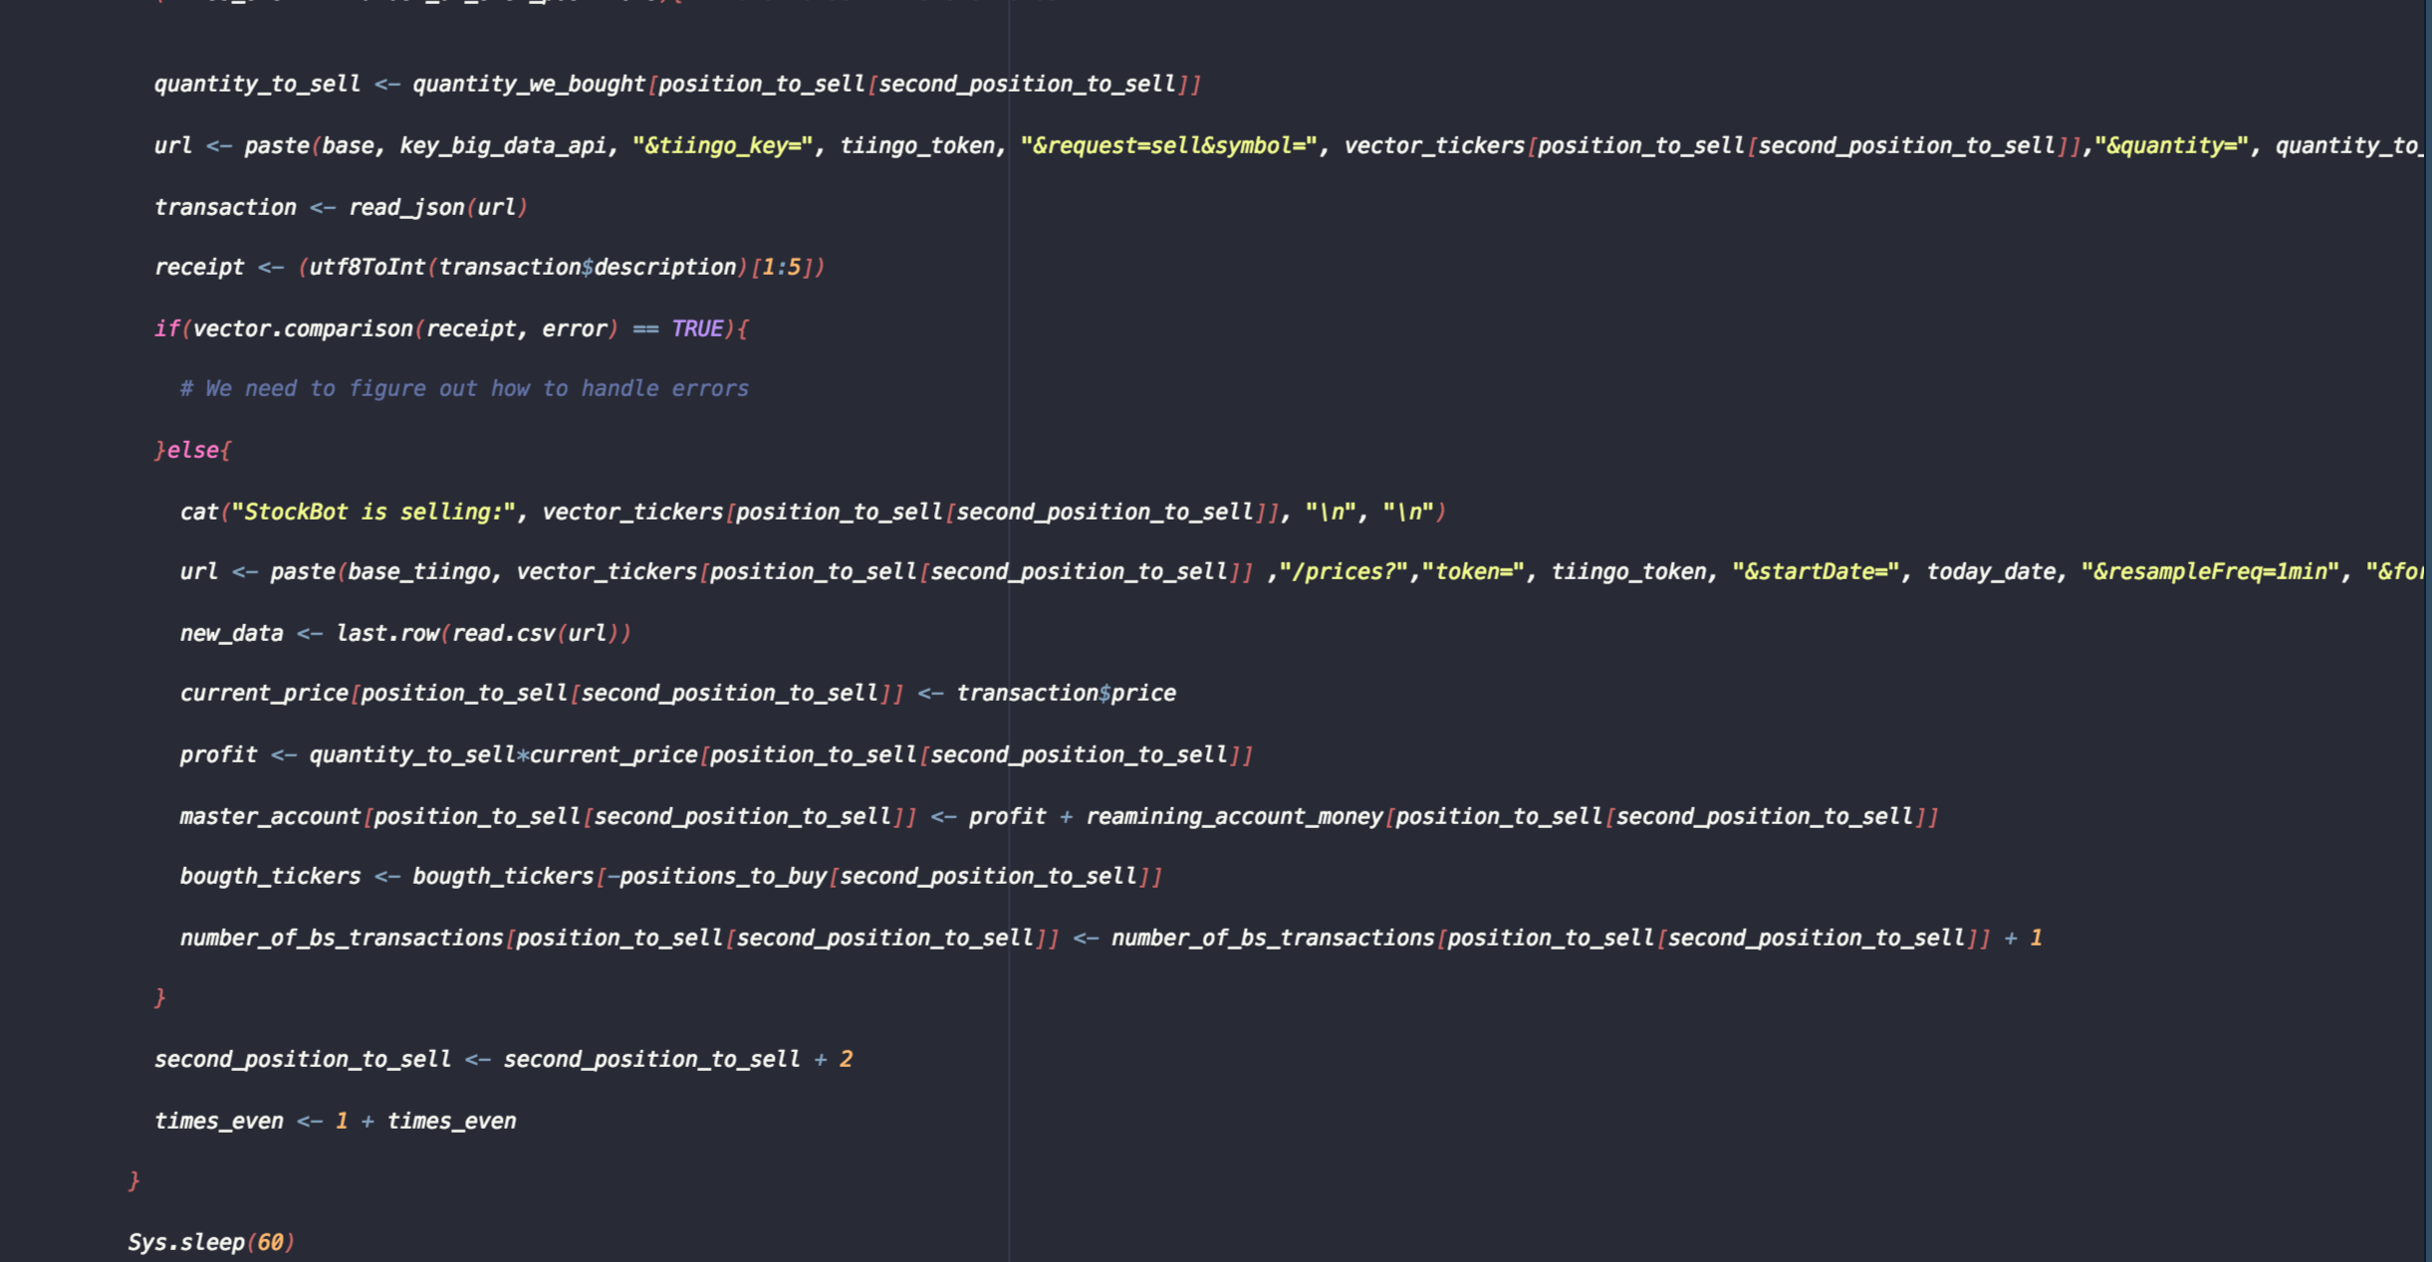
Selling Stocks

Slide 13
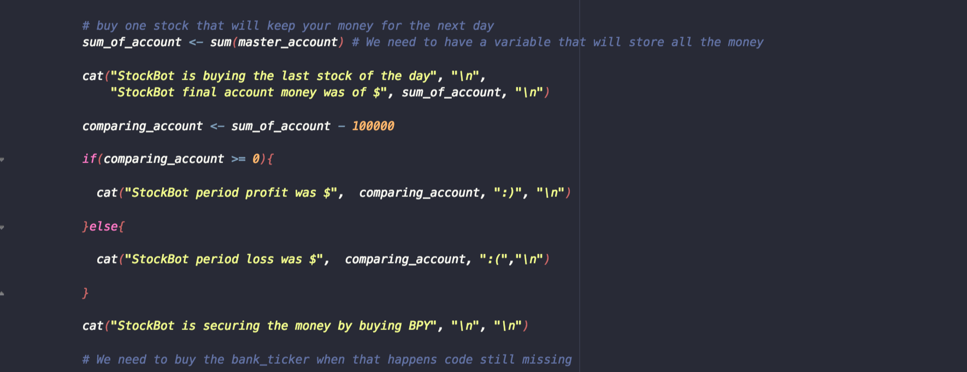
Making sure we can know how much money was lost, what was our profit and if we were able to buy our “emergency” stock BPY

Slide 14
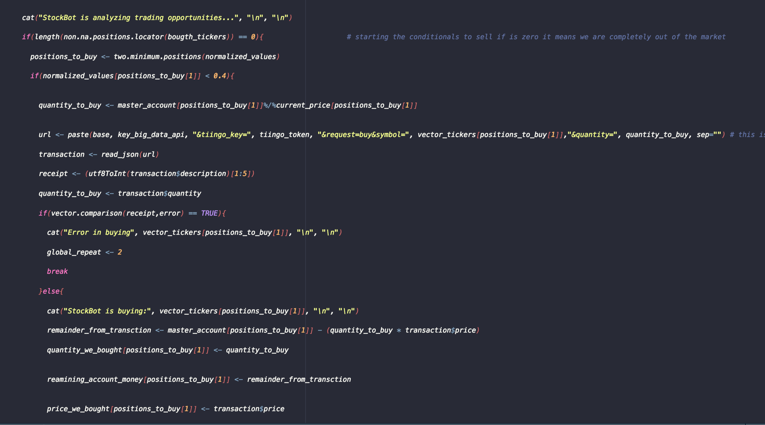
Buying Stocks

Slide 15

Crystal Ball

Slide 16
The project
The objective of our project was to create an automated function based script that gets the most recent data of the FAANG stocks and perform predictions about the next 30 minutes.
Also, our program would calculate the metrics of the prediction of the stocks. The according to the predictions we would then classify the stocks into up, down, or same.
The testing set had to be of at least one month worth of historical data and the training at least two months.
Finally, we utilized the tiingo API for the purpose of the project.

Slide 17
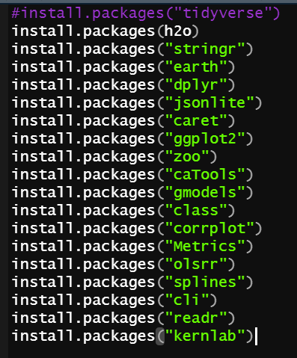
Libraries Utilized

Slide 18
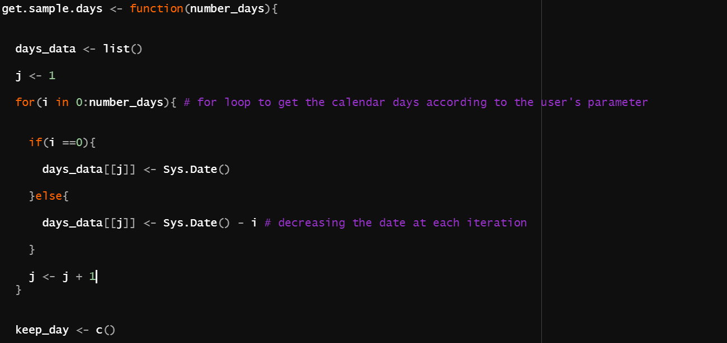
The algorithm

Slide 19
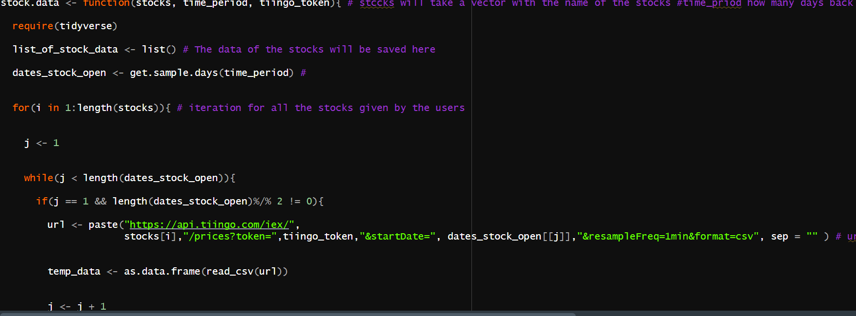
The algorithm

Slide 20
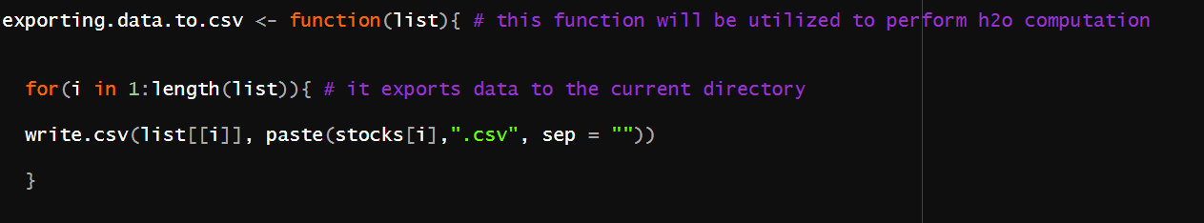
The algorithm

Slide 21
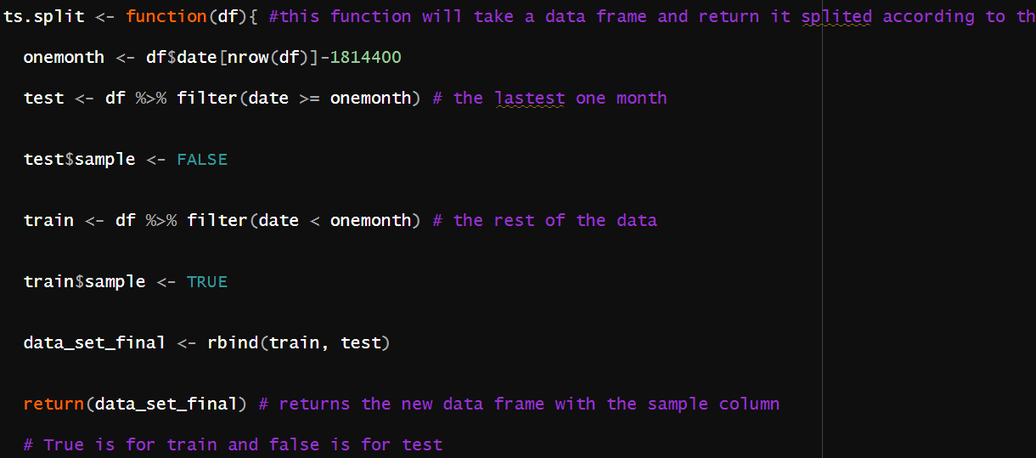
The algorithm

Slide 22
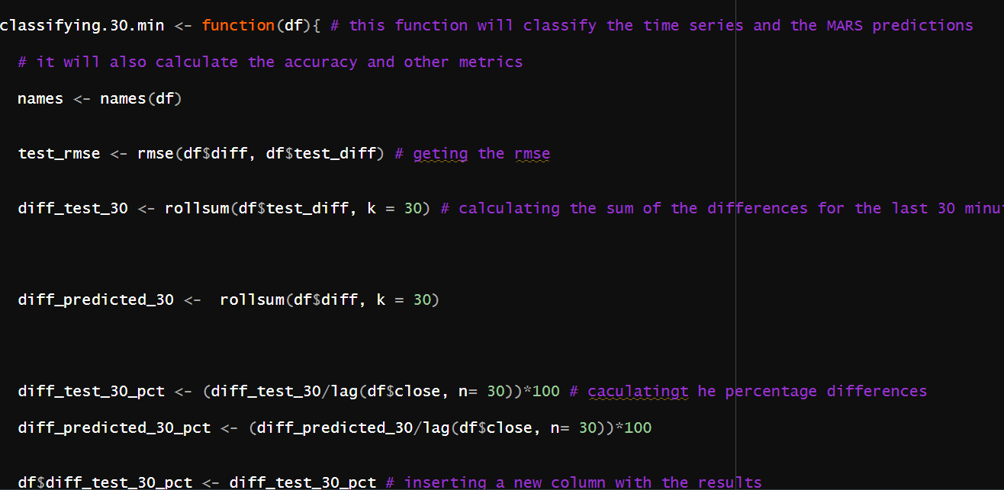
The algorithm

Slide 23
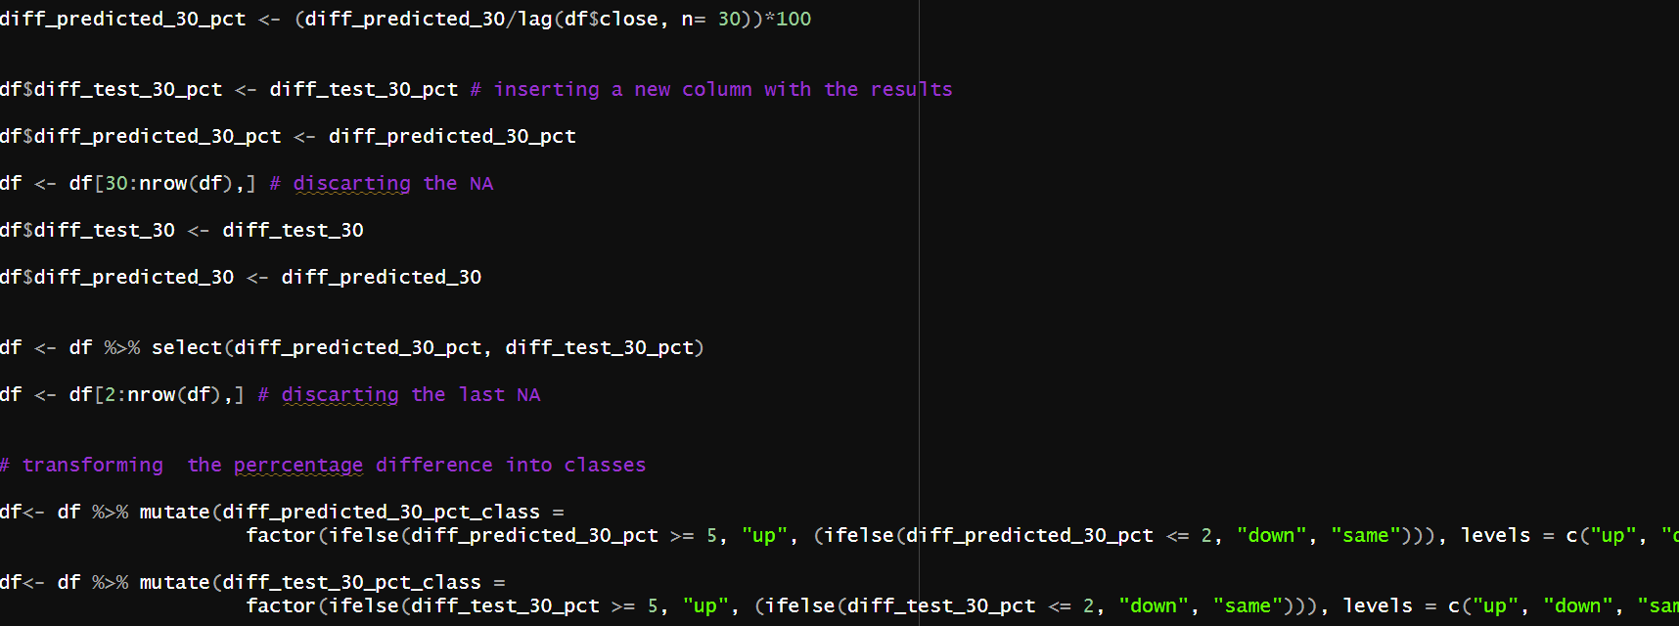
The algorithm

Slide 24
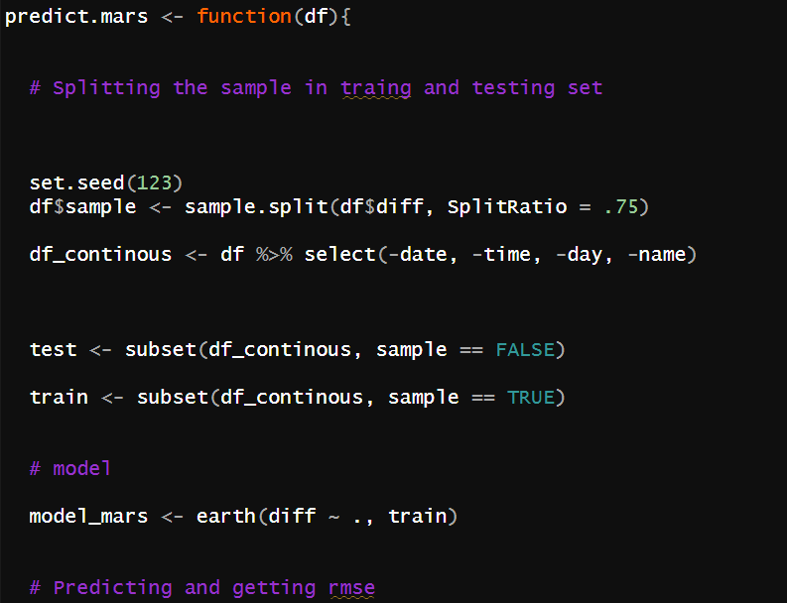
The algorithm

Slide 25
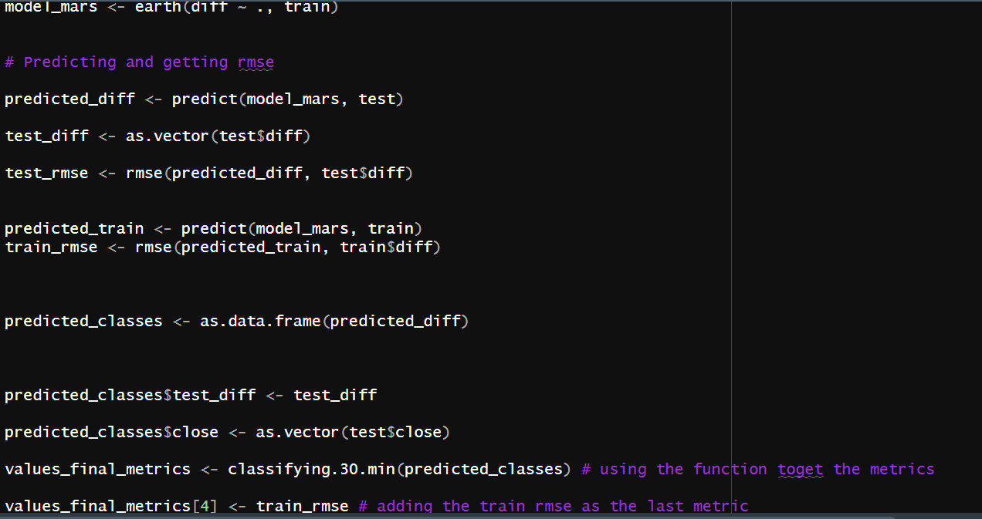
The algorithm

Slide 26
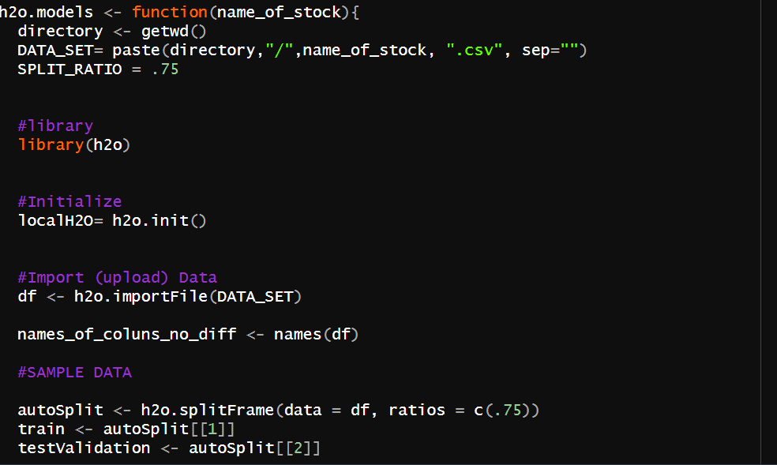
The algorithm

Slide 27
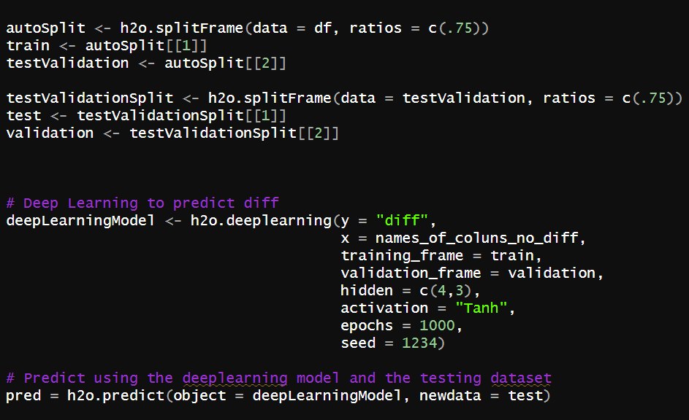
The algorithm

Slide 28
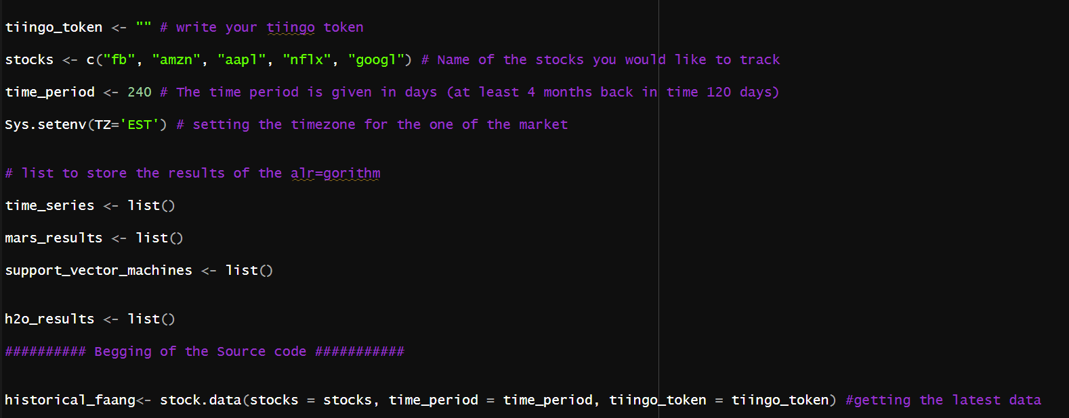
The algorithm

Slide 29
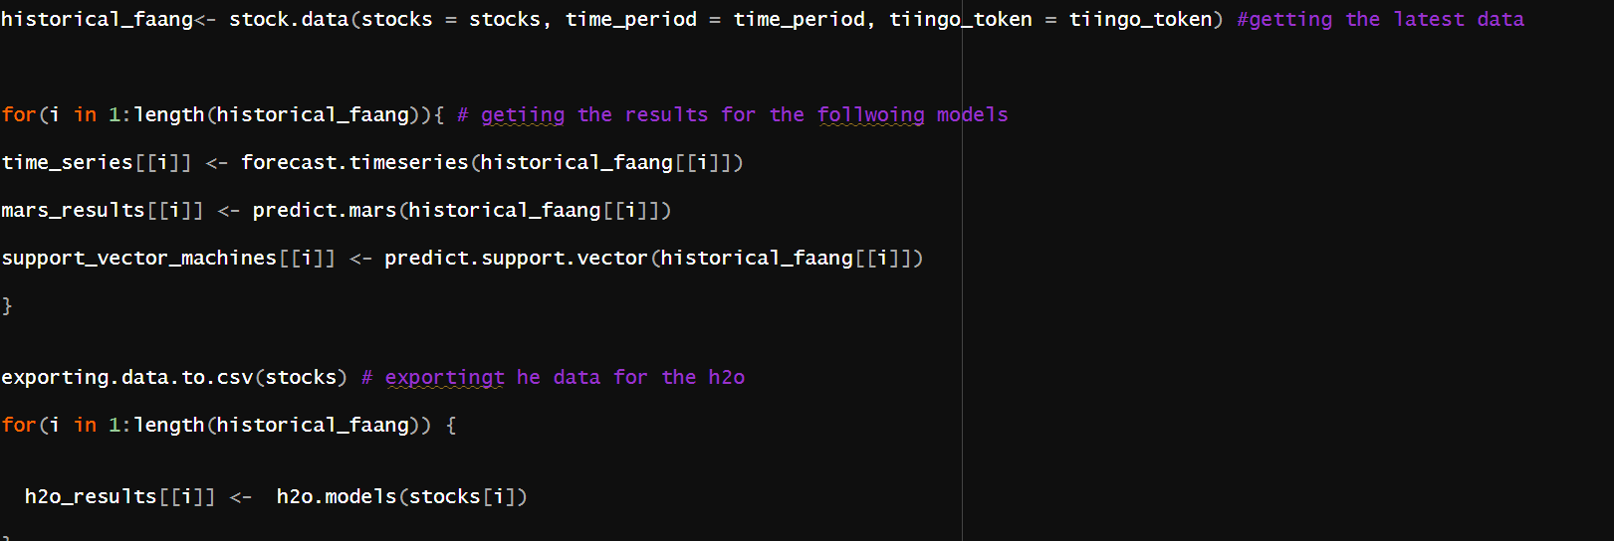

Slide 30
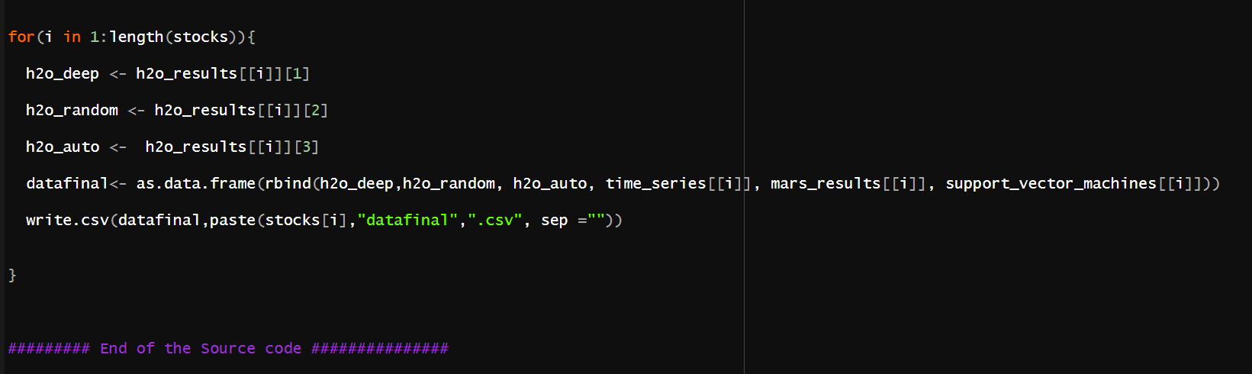
The algorithm

Slide 31
THANK YOU!

